Slide 1
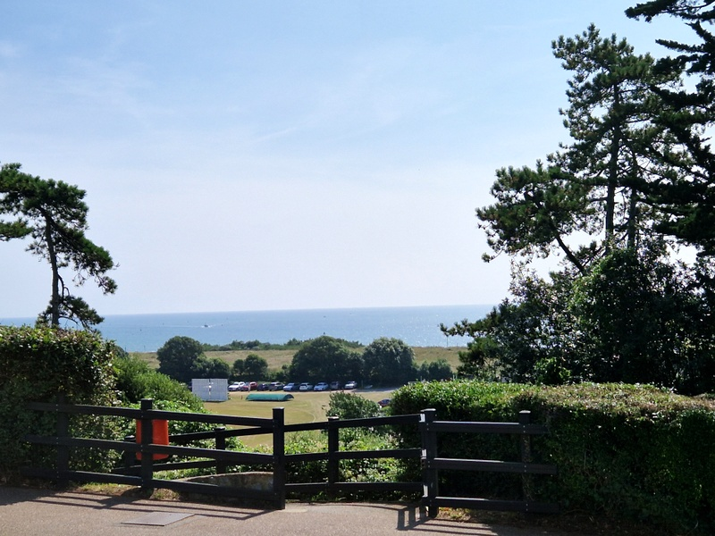
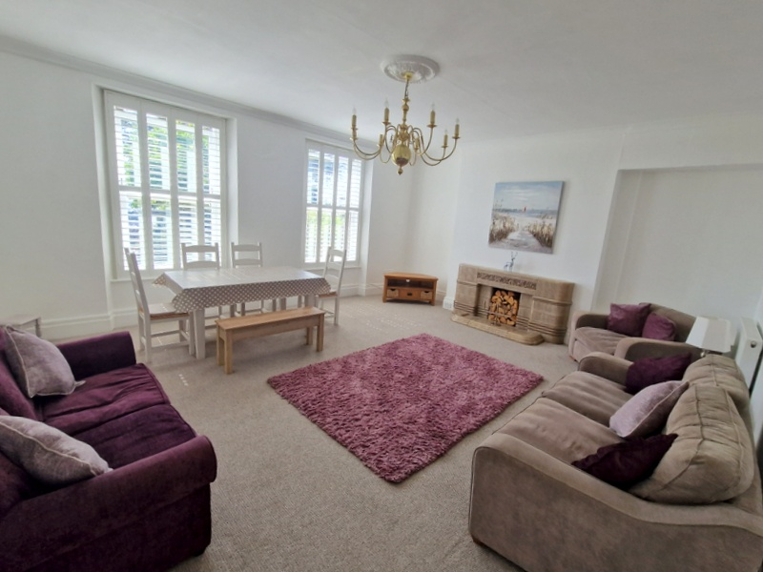
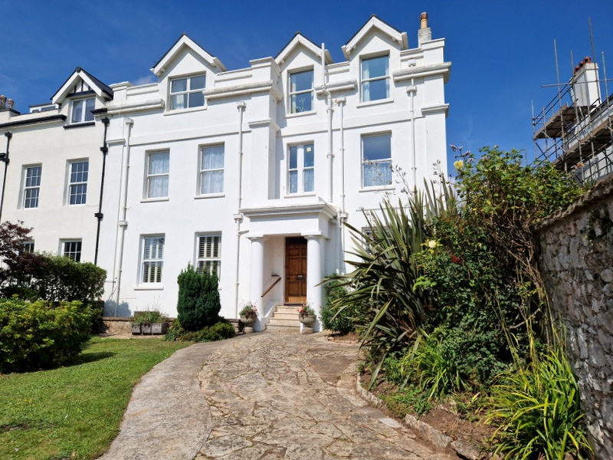
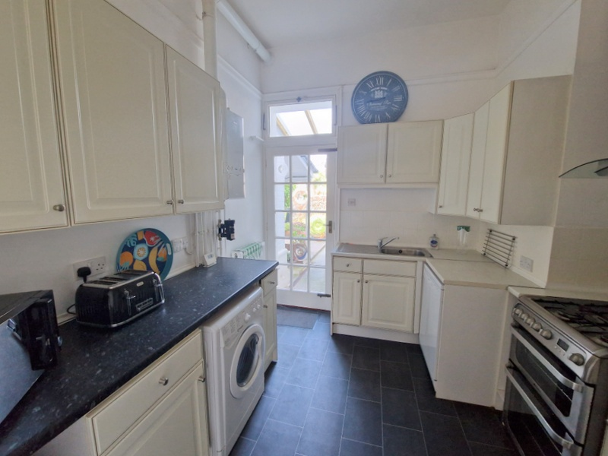
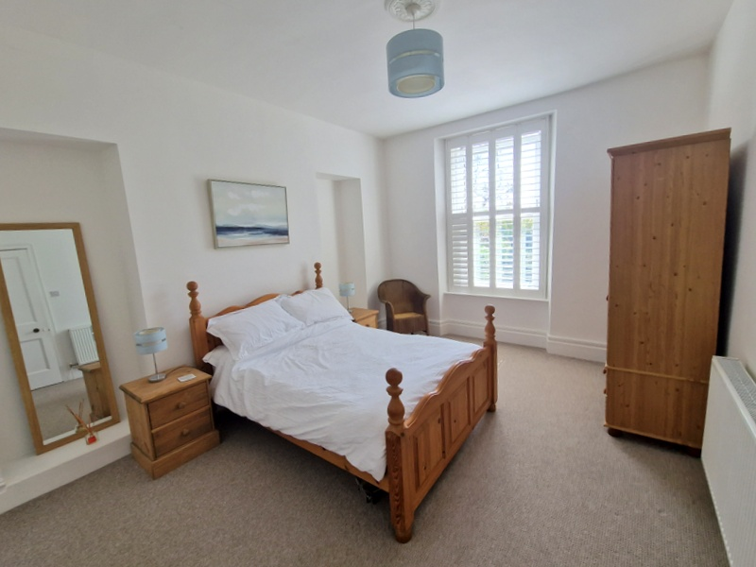
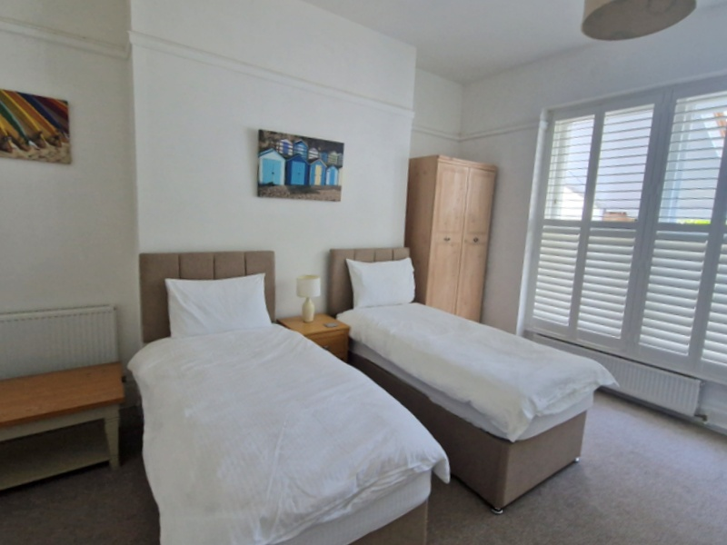
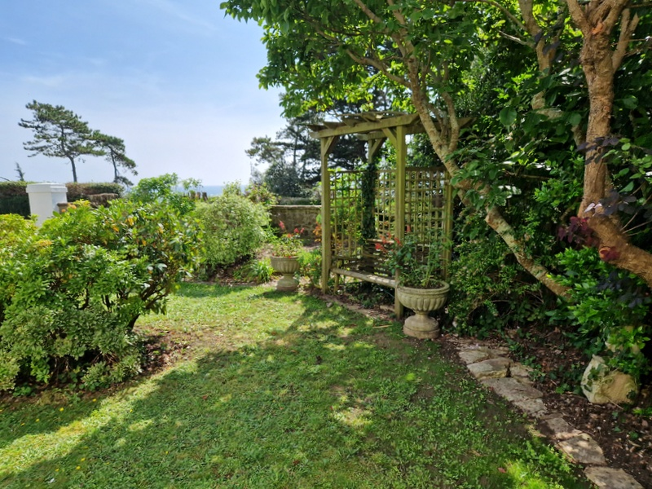
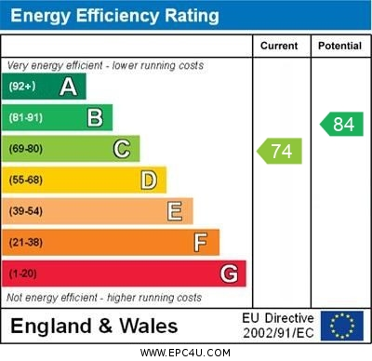
www.pennys.net
Apartment 1 The White House, 5 Trefusis Terrace, Exmouth, EX8 2AX
GUIDE PRICE £450,000
TENURE Leasehold
An Elegant And Spacious Ground Floor Apartment Forming Part Of An Impressive Period Building Enjoying A Wonderful Seafront Location With Driveway Parking And Own Attractive Gardens
Impressive Private Entrance * Elegant Lounge/Dining Room *Kitchen * Two Double Bedrooms – Both With En-Suites * Gas Central Heating Via Modern Boiler * Double Glazed Windows * Superb Permanent Or Holiday Home Retreat * No Onward Chain
Pennys Estate Agents Limited for themselves and for the vendor of this property whose agents they are give notice that:- (1) These particulars do not constitute any part of an offer or a contract. (2) All statements contained in these particulars are made without responsibility on the part of Pennys Estate Agents Limited. (3) None of the statements contained in these particulars are to be relied upon as a statement or representation of fact. (4) Any intending purchaser must satisfy himself/herself by inspection or otherwise as to the correctness of each of the statements contained in these particulars. (5) The vendor does not make or give and neither do Pennys Estate Agents Limited nor any person in their employment has any authority to make or give any representation or warranty whatever in relation to this property.
PENNYS ESTATE AGENTS
2 Rolle House, Rolle Street, Exmouth, Devon, EX8 2SN
Tel: 01395 264111 EMail: help@pennys.net

Slide 2
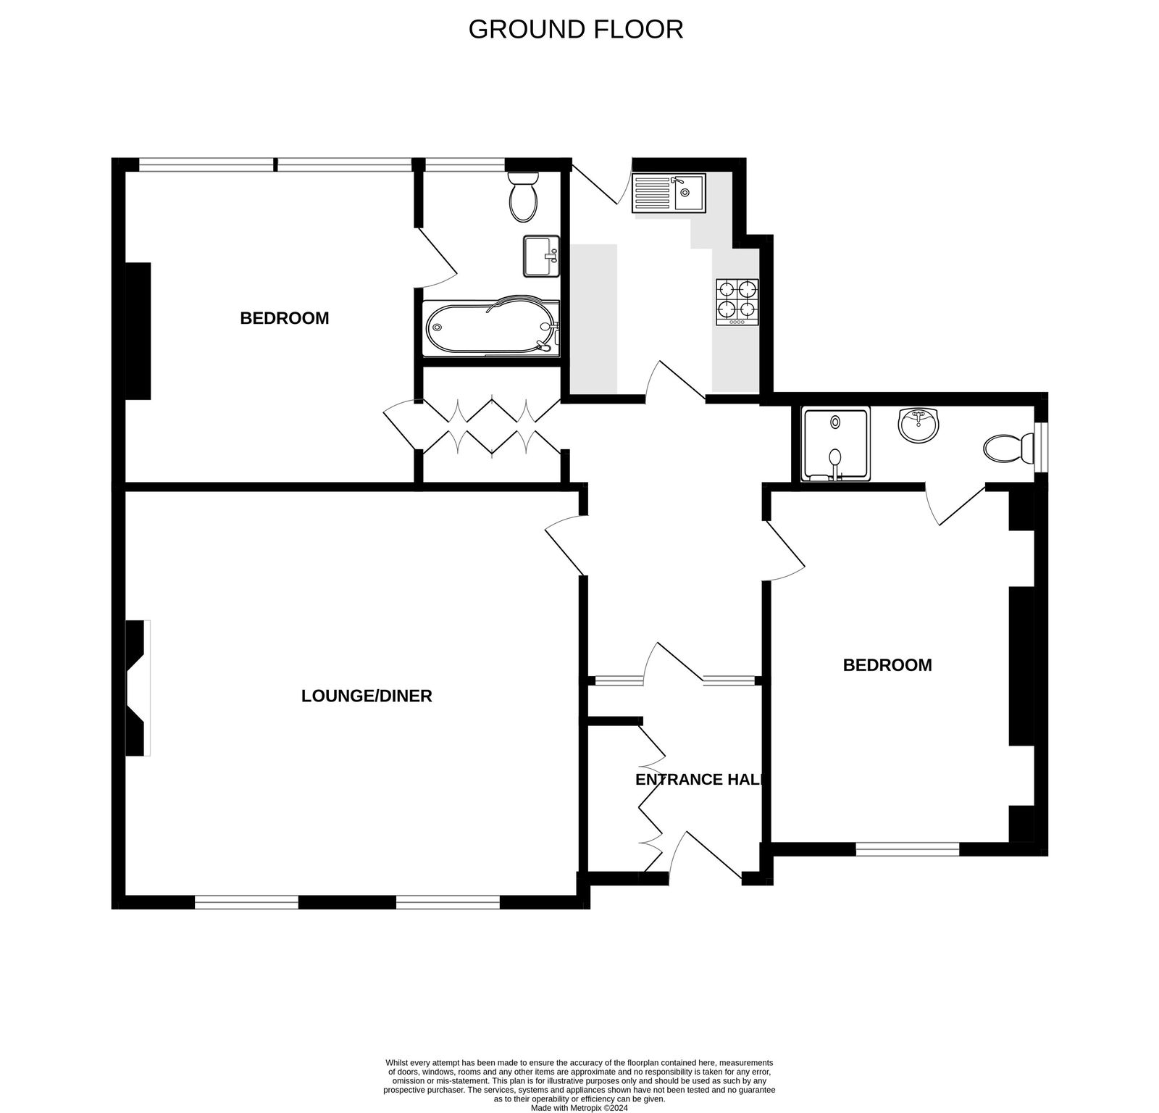
Apartment 1 The White House, 5 Trefusis Terrace, Exmouth, EX8 2AX
Pennys is delighted to offer for sale this stunning ground floor apartment ideally located just off Exmouth seafront. The accommodation is both spacious and elegant with some fine period features. A rare feature of the apartment is the ample parking and attractive gardens located directly to the front of the property.
THE ACCOMMODATION COMPRISES: The apartment enjoys original main entrance to the property with an impressive open entrance pillared porchway with solid wood private front door giving entrance to:
ENTRANCE VESTIBULE: With fitted cupboards, picture rail, solid wood inner door with window inset and matching picture window and side screens, solid wood flooring, part glazed door to:
RECEPTION HALL: Modern electric consumer unit, two radiators, picture rail, fitted range of cupboards.
LOUNGE/DINING ROOM: 6.02m x 5.46m (19'9" x 17'11") A most spacious and elegant living space with original tiled fireplace with matching hearth and grate, two uPVC double glazed sash style windows both fitted with wooden window shutters overlooking the front aspect and gaining views to the sea, two radiators, TV point, coved ceiling.
KITCHEN: 3m x 2.82m (9'10" x 9'3") Comprising a range of cupboards and drawer units, space for automatic washing machine under working surfaces with tiled surround, wall mounted cupboards, gas and electric cooker points, space for upright fridge/freezer, inset single drainer sink unit set into work surface, radiator, modern Ideal gas boiler for hot water and central heating, glazed panelled door providing rear access.
BEDROOM 1: 4.7m x 3.86m (15'5" x 12'8") With uPVC double glazed sash style windows to front aspect fitted with wooden window shutters and gaining views to the sea, radiator.
EN-SUITE SHOWER ROOM/WC: 3.25m x 1.07m (10'8" x 3'6") Fitted with a shower cubicle with splashback walls and Mira shower unit, pedestal wash hand basin with fitted mirror over, WC with push button flush, radiator, extractor fan and window with patterned glass.
BEDROOM 2: 4.65m x 3.51m (15'3" x 11'6") Spacious double bedroom with sash windows overlooking the rear aspect with fitted window shutters, two radiators, picture rail.
EN-SUITE BATHROOM/WC: 2.57m x 1.88m (8'5" x 6'2") Stylishly fitted with modern suite comprising bath with feature coloured splashback walls, shower unit and shower splash screen, vanity style wash hand basin with mirror fronted medicine cabinet over with display lighting over, WC with push button flush, chrome heated towel rail, picture rail, sash window with fitted wooden window shutters, radiator.
OUTSIDE: The property is accessed via a pillared entrance and boasts ownership of the front garden, which is attractively planned and laid to lawn with a pergola seating area and well stocked flower and shrub beds. The drive is part of the property (not shared) and able to accommodate two vehicles.
TENURE & OUTGOINGS: The apartment benefits from a share of the freehold and is held on a 999 year lease. Service/Management Charge: £50 per month.
Mortgage Assistance
We are pleased to recommend Meredith Morgan Taylor, who would be pleased to help no matter which estate agent you finally buy through. For a free initial chat please contact us on 01395 264111 to arrange an appointment. Your home may be repossessed if you do not keep up repayments on your mortgage. Meredith Morgan Taylor Ltd is an appointed representative of Openwork Limited, a trading style of Openwork Ltd which is authorised and regulated by the Financial Conduct Authority (FCA).
FLOOR PLAN:

